Slide 1
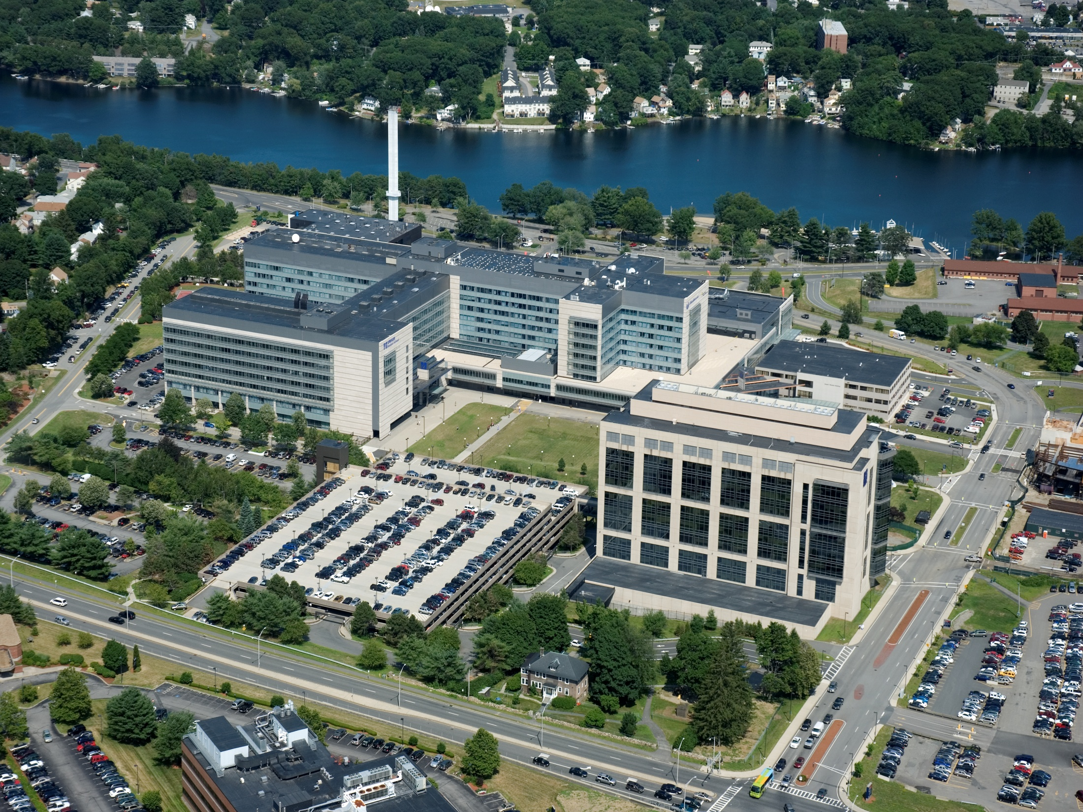
UMMS 2013 Alumni Survey Report Response Rate: 27% (364/1364)
Notes:
To Edit the Date go to View> Slide Master
On the Title Slide Master, select the text box with the date and edit.

Slide 2
Survey Methodology
Developed in collaboration with I.S. & U.I.T.S.
Disseminated first institution-wide alumni survey in October 2010
UMMS surveyed graduates celebrating their 5th, 10th, 15th, etc. anniversary (Classes of 1977, 1982, 1987, 1992, 1997, 2002, and 2007)
Analysis and reporting conducted by IREA
UMMS 2013 Alumni Survey Report

Slide 3
Response Rate By School
Response Rate by School | Percent
Graduate School of Biomedical Sciences | 15% (23/151)
Graduate School of Nursing | 76% (52/68)
School of Medicine and Graduate Medical Education* | 25% (289/1145)
All Schools | 27% (364/1364)
*SoM and GME response rates combined because they were listed once in master dataset.
Tables produced by the Office of Institutional Research, Evaluation, & Assessment.
UMMS 2013 Alumni Survey Report

Slide 4
Graphs produced by the Office of Institutional Research, Evaluation, and Assessment.
UMMS 2013 Alumni Survey Report

Slide 5
Clinical Practice License in Massachusetts By School
Obtained initial license in MA | Percent
School of Medicine | 50% (52/104)
Graduate Medical Education | 54% (54/100)
Overall* | 48% (86/178)
This information not requested from GSBS respondents.
*Respondents who graduated from SoM and GME are included in tables for both schools.
Tables produced by the Office of Institutional Research, Evaluation, & Assessment.
UMMS 2013 Alumni Survey Report

Slide 6
Initial/Current License in Massachusetts By School
Obtained at least one (initial or current) license in MA | Percent
Graduate School of Nursing | 44% (4/9)
School of Medicine | 60% (67/112)
Graduate Medical Education | 55% (61/111)
Overall* | 54% (110/205)
This information not requested from GSBS respondents.
*Respondents who graduated from SoM and GME are included in tables for both schools.
Tables produced by the Office of Institutional Research, Evaluation, & Assessment.
UMMS 2013 Alumni Survey Report

Slide 7
Type of Practice/Position All UMW Schools and by school*
Practice Settings | All Schools | Graduate School of Nursing | School of Medicine | Graduate Medical Education
Academic Health Center | 15% (49/321) | 18% (9/50) | 15% (25/162) | 13% (19/151)
Hospital-based Specialty Care (e.g., pathology, ER) | 20% (63/321) | 14% (7/50) | 22% (36/162) | 21% (32/151)
Office-based Specialty Care (including hospital care) | 16% (52/321) | 4% (2/50) | 15% (24/162) | 23% (35/151)
Ambulatory Care (including associated hospital care) | 9% (29/321) | 4% (2/50) | 9% (15/162) | 11% (16/151)
This information not requested from GSBS respondents.
*Respondents who graduated from SoM and GME are included in tables for both schools.
Tables produced by the Office of Institutional Research, Evaluation, & Assessment.
UMMS 2013 Alumni Survey Report

Slide 8
Primary Specialty in Primary Care By School*
Primary Specialty in Primary Care | Graduate School of Nursing | School of Medicine | Graduate Medical Education
Family Medicine |  | 14% (23/168) | 12% (19/156)
Internal Medicine | 29% (2/7) | 25% (42/168) | 22% (34/156)
Internal Medicine/Pediatrics |  | 2% (4/168) | 3% (4/156)
Pediatrics |  | 13% (22/168) | 10% (15/156)
Subtotal Primary Care | 29% (2/7) | 54% (91/168) | 46% (72/156)
Emergency Medicine |  | 13% (22/168) | 10% (15/156)
OB/GYN |  | 4% (7/168) | 3% (4/156)
Total Primary Care | 29% (2/7) | 71% (120/168) | 58% (91/156)
This information not requested from GSBS respondents.
*Respondents who graduated from SoM and GME are included in tables for both schools.
Tables produced by the Office of Institutional Research, Evaluation, & Assessment.
UMMS 2013 Alumni Survey Report

Slide 9
Graphs produced by the Office of Institutional Research, Evaluation, and Assessment.
UMMS 2013 Alumni Survey Report

Slide 10
*Respondents who graduated from SoM and GME are included in tables for both schools.
Tables produced by the Office of Institutional Research, Evaluation, & Assessment.
UMMS 2013 Alumni Survey Report

Slide 11
Location of Research All UMW Schools Combined
Highest three percentages where research takes place | Percent
Hospital | 55% (46/84)
University | 20% (17/84)
Community | 11% (9/84)
Tables produced by the Office of Institutional Research, Evaluation, & Assessment.
UMMS 2013 Alumni Survey Report

Slide 12
Current Research All UMW Schools Combined
If currently involved in research, select all that apply. | Percent
Basic | 12% (11/90)
Clinical | 78% (70/90)
Translational | 16% (14/90)
Other | 9% (8/90)
Tables produced by the Office of Institutional Research, Evaluation, & Assessment.
UMMS 2013 Alumni Survey Report

Slide 13
Moving forward…
Each year graduates celebrating their 5th, 10th, 15th, etc. anniversary will be asked to complete alumni survey
The annual results will provide career information about alumni, which will allow for better tracking of the success of UMMS graduates
UMMS 2013 Alumni Survey Report

Slide 14
Questions?

