Slide 1
BAY STATE BATTALION
ARMY ROTC

Slide 3
WHAT IS ROTC?
USMA 22%
#1 Producer of Army Officers
~ 5500 Annually
Over 1,100 colleges and
universities (275 “host” Programs)
Reserve* Component
OCS 19%
ROTC 59%
Active Duty
* 98% of Reserve Component Mission
Brings experiential, ethnic and cultural diversity to the Officer Corps
Teaches leadership, management skills, and discipline that will enhance your future success in either a military or a civilian career
“The Best Leadership Course in America”
…You get to be a College Student

Slide 4
FACULTY AND STAFF
Professor of Military Science………………………………………….. LTC Adam Heppe (Aviation)
MSIV Instructor
Senior Enlisted Advisor ……………………………………………….. MSG Alan Sutton (Infantry)
MSIII Instructor
UMass Lowell OIC ……………………………………………………. MAJ Joseph Irwin (Logistics)
MSII Instructor
Fitchburg State OIC……………….. …………………………………... Mr. Arthur Elbthal (COL(R))
MSI Instructor
Executive Officer…..…………………………………………………… MAJ Mark Liarikos (Civil Affairs)
Operations and Training NCO………………………………………… SFC Erik Mejia (Infantry)
Human Resources Tech ………………………………………………. Mrs. Den Fitch (LTC (R))
Recruiting Operations ………………………………………………… Mr. Darryl Gill (CSM (R))
Logistics Tech …………………………………………………………... Mrs. Sharon Parry
Administrative Assistant ……………………………………………….. Mrs. Kim Adams

Slide 5
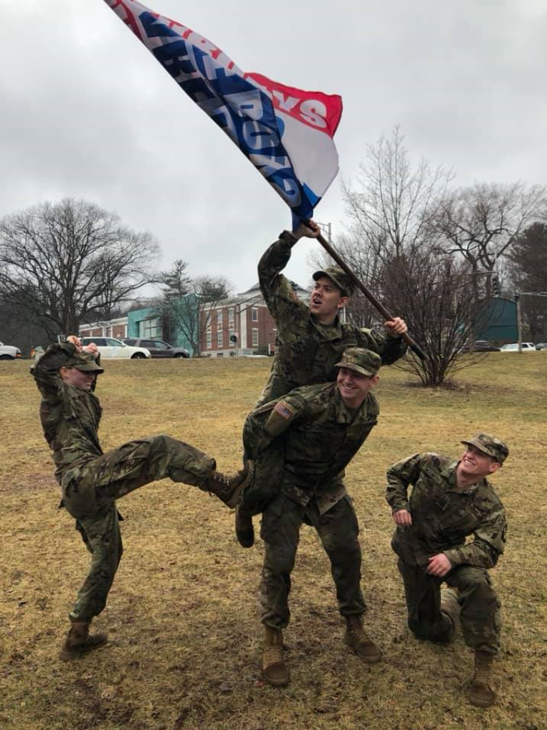
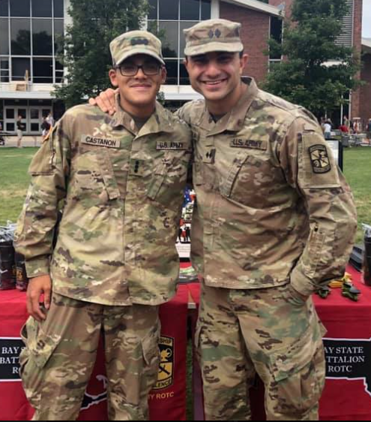
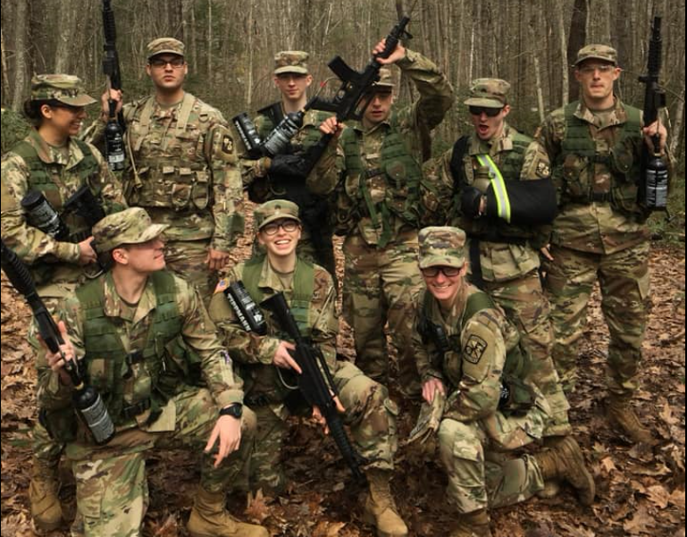
BAY STATE BATTALION MISSION
The Bay State Battalion recruits, educates, trains, and inspires Cadets throughout Central Massachusetts in order to commission second lieutenants of character for the US Army who are prepared to answer our nation’s call.

Slide 6
WHO ARE WE?
2/3 of our Cadet are Varsity Athletes
1/3 of our Cadets are serving in the National Guard
Engineering and Criminal Justice are the most popular majors.
Serve In Leadership Roles across campus:
Football Captain
Wrestling Captain
Fraternity Vice President
Club Presidents
Police Academy Commandant
Alumni Relations Representative

Slide 7
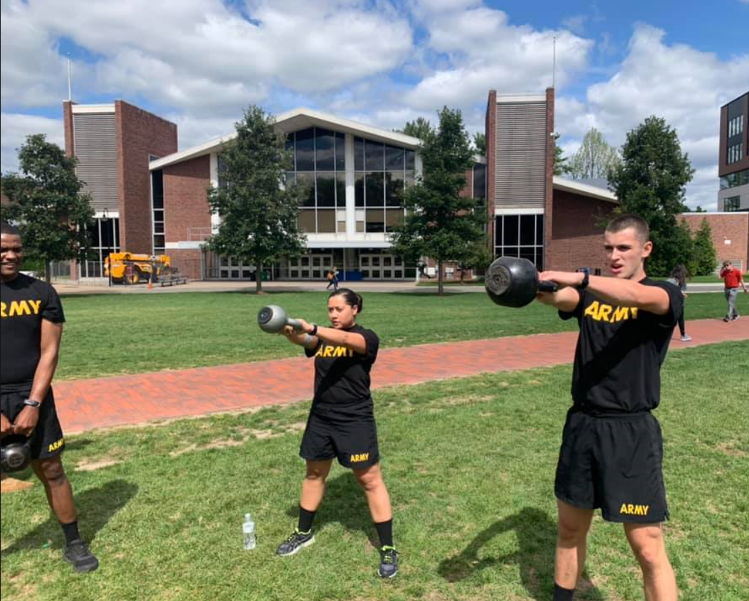
Available Nurse Scholarships
National Nursing Scholarships
4-year scholarship
3-year scholarships
Minuteman Scholarships
Army Reserve
On campus scholarships
3, 2.5, and 2-year scholarships
* 98% of Reserve Component Mission

Slide 8
ROTC OPPORTUNITIES
Scholarships
$1,936,490 in Scholarship Money
Full Tuition & Fees; Room & Board - (from Assumption and WPI)
12 freshmen earned 3/4 YR Scholarships in AY 19-20
Research or Specialty Internships
NSA, Corps of Engineers, Army Research Labs, Defense Threat Reduction Agency
Cadet Troop Leader Training (CTLT)
Lieutenant Internship with an Active Duty Unit
Hawaii, Texas, South Carolina
Military Schools
Airborne, Air Assault, Mountain Warfare, SAPPER
JCLC (JROTC Leadership Camp)
All ROTC programs are fully funded

Slide 9
A Typical ROTC Week
THE ROTC EXPERIENCE
A Typical ROTC Summer
Monday – Physical Training 0600-0700
Tuesday – Tactical Class (taught by Cadets) 1600-1700
Wednesday – Physical Training 0600-0700
Thursday – Leadership Lab 1500-1700
Friday – Physical Training 0600-0700
Friday – Military Science Class 1000-1100
Freshman Year – Support JROTC JCLC (1 week)
Sophomore Year – Airborne School or Internship (3-5 weeks)
Junior Year – Cadet Summer Training, Cadet Troop Leader Training (6-10 weeks)
Senior Summer – Commissioning and Basic Officer Leader Course

Slide 10
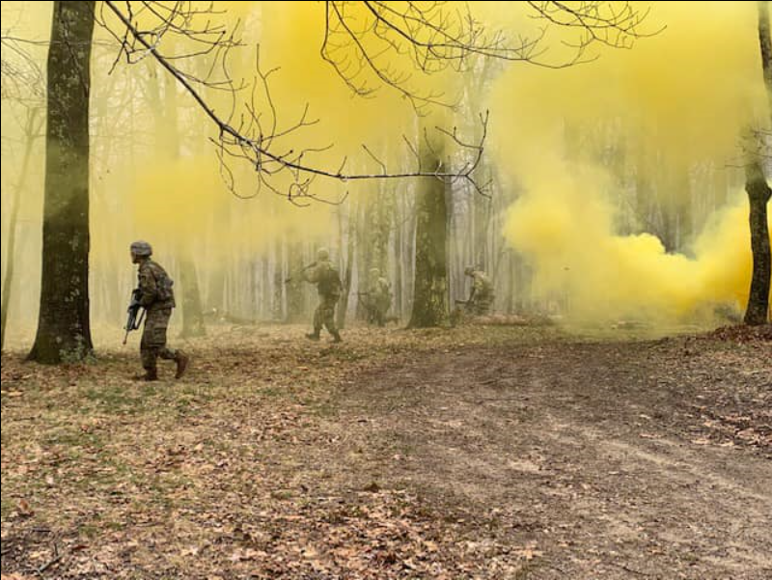
FALL SEMESTER
Orientation Weekend
Squad Lane Training at Fort Devens (28 SEP)
Army 10-miler (12-14 OCT) (select Cadets)
Ranger Challenge (18-20 OCT) (select Cadets)
Fall Field Training Exercise (25-27 OCT)
Land Navigation at Fort Devens (16 NOV)
Battalion Dining-In (19 NOV)
Combat Water Survival Training (25 NOV)
Cadet Battalion Change of Command (4 DEC)

Slide 11
WHAT AM I SIGNING UP FOR?
Here’s the BLUF – Bottom Line Up Front
There is NO (Zero, Nada, Nichts) military obligation for Freshman/Sophomore ROTC Cadets
Contracting (not enrolling) results in a service obligation
Contracted ROTC Cadets do NOT get deployed
Enlistment in the NG or Reserves works with ROTC
Simultaneous Membership Program (SMP) – but not required
Commissioning = 8 years of service
8 years in the National Guard or Reserves
3 years active + 5 years IRR/National Guard or Reserves
4 years active + 4 years IRR/Nation Guard or Reserves (Scholarship)
This is NOT Basic Training

Slide 12
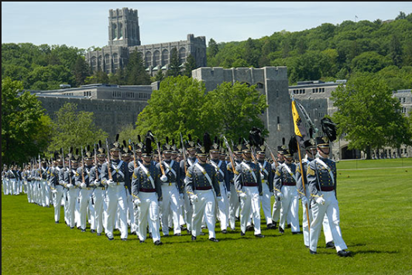
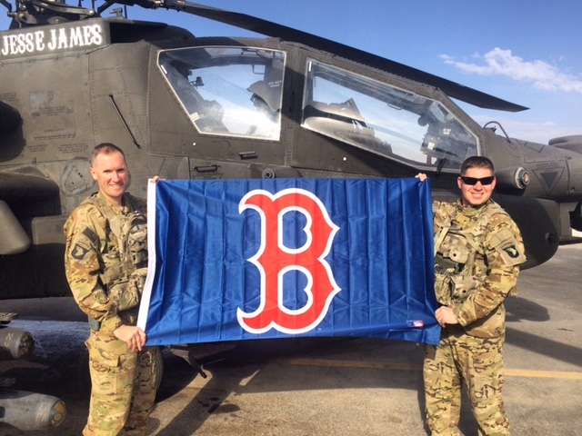
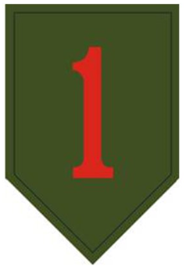
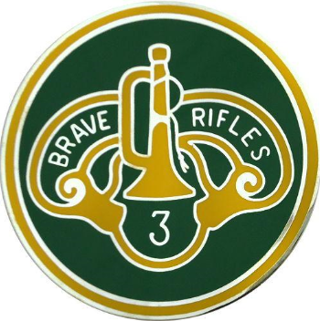
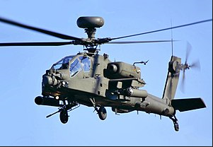
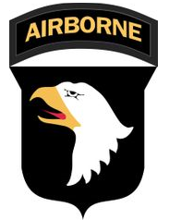
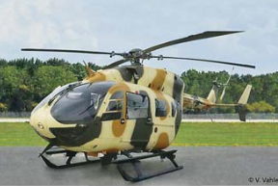
LTC Adam D. Heppe AH-64 Apache Pilot – WPI ROTC Commander
USMA ‘02
AH-64 APACHE
UH-72 LAKOTA
Kandahar, Afghanistan 2015
WRHS
Class of ‘98
Cadet
Platoon Leader
Commander
OC/T
Operations Officer
Professor
OPN Iraqi Freedom
OPN Iraqi Freedom
Operation Enduring Freedom
Flight School
JMRC
Balad, Iraq
Baghdad, Iraq
Kandahar, AFG
99 02 05 08 11 14 17 20
West Point, NY
Alabama
Germany
Ft Hood, TX
Germany
KS
Fort Campbell, KY
WPI

Slide 13
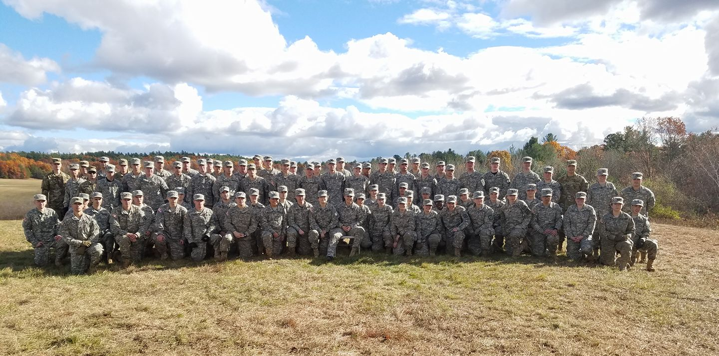
QUESTIONS AND COMMENTS

