Slide 1
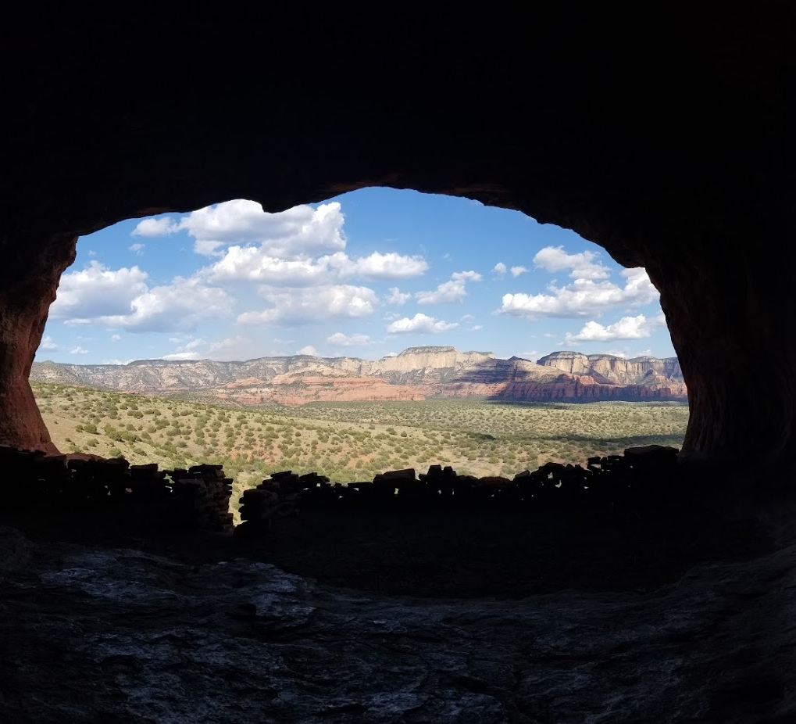
A Look into the Lives of Navajo People in the 21st Century
Tiffany Chen, MS4
Jason Lau, MS4
January 7, 2019

Slide 2
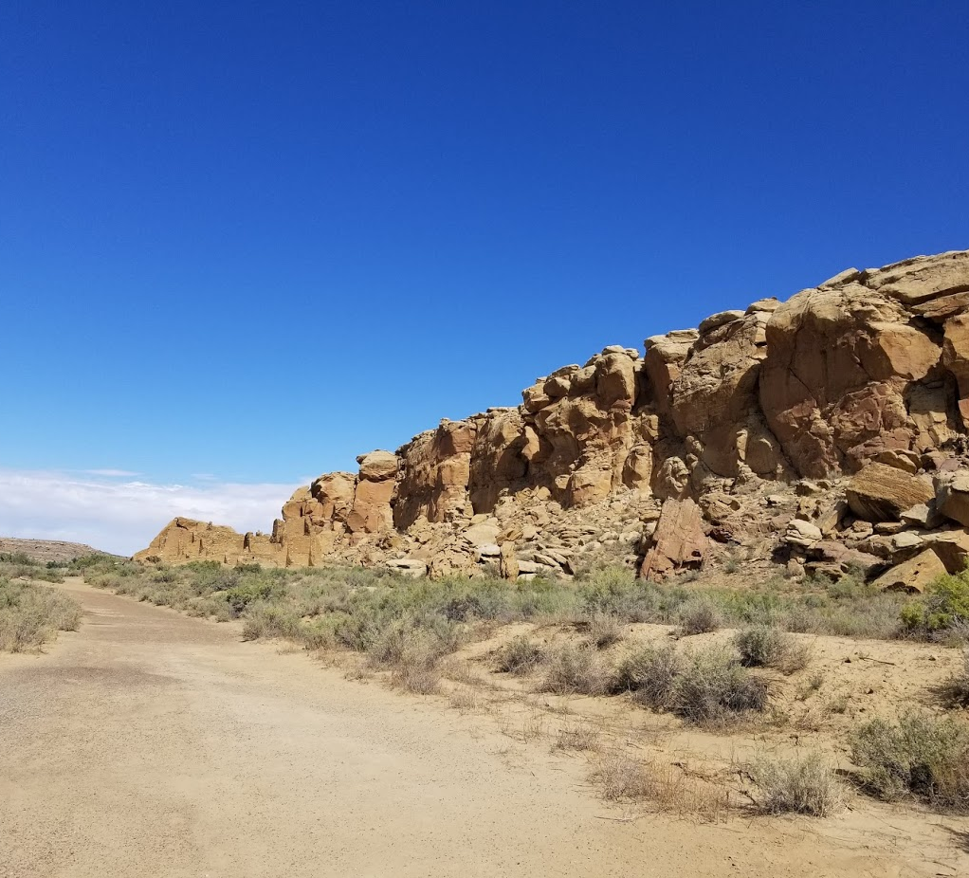
Roadmap
Introduction
Preconceptions
Why did we want to go?
What was our role?
Where did we go?
How did we get there?
Stories and Lessons
People are not textbook
Perception towards Western medicine
Traditional medicine
Relationship with Nature
Resilience
Celebration and Tradition
Takeaways
Changing our attitudes
Would we go again?

Slide 3
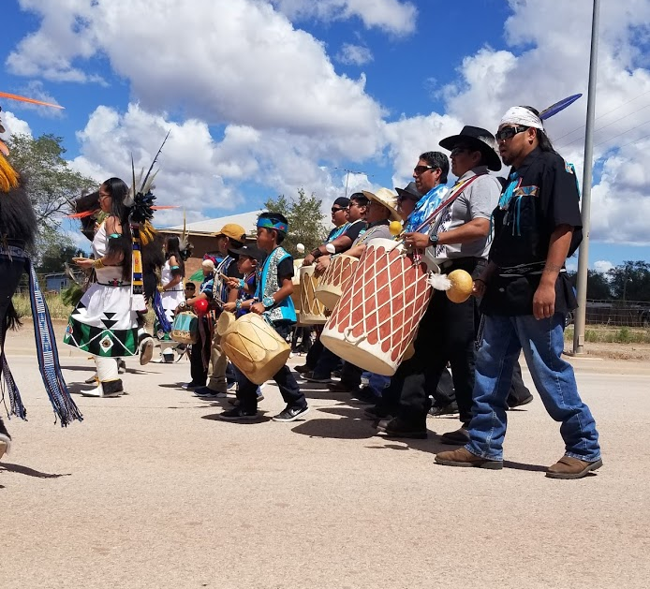
Introduction
Mila and Grandpa
Notes:
Mila comes in with her Grandpa for a well-child visit. She’s 7 years old, very shy, barely says a word but nods yes or no when I ask her questions. From the last few notes, she has had social worker involvement and extra resources for a speech delay. Grandpa also only has partial custody last we heard and my preceptor mentioned wanting to know what will happen with dad.
Grandpa says that Mila’s father is returning from prison soon and he will be helping to take care of Mila. Her mother is out of the picture. She is still in prison for drugs and hasn’t been part of taking care of Mila.
I give her a book and she’s takes it and runs behind the exam table enthusiastically opening it to read. He shares how Mila has not only caught up to her class but is doing better than many of her classmates. She is very smart and learns quickly.
Mila is like any other 7 year old, just quiet. When I couldn’t coax her out from behind the exam table, Grandpa called her over and she came out and hugged his leg while looking at me with uncertainty. We finish up the discussion and physical exam.
I excuse myself and talk to my preceptor, I comment how well taken care of Mila is and how amazing it is she’s improved. He says,
“these are a people whose culture was destroyed only three generations ago. Many grandpas and grandmas grew up without parents and didn’t really know how to parent when they had kids. That generation is often out of the picture and shattered from drugs and alcohol.”
“Now, in many families, the grandparents are raising the grandkids. They are much better parents, having had a second chance.”

Slide 4
Preconceptions
Notes:
https://worldhistory.us/wp-content/uploads/2017/05/history-of-the-first-thanksgiving.jpg

Slide 5
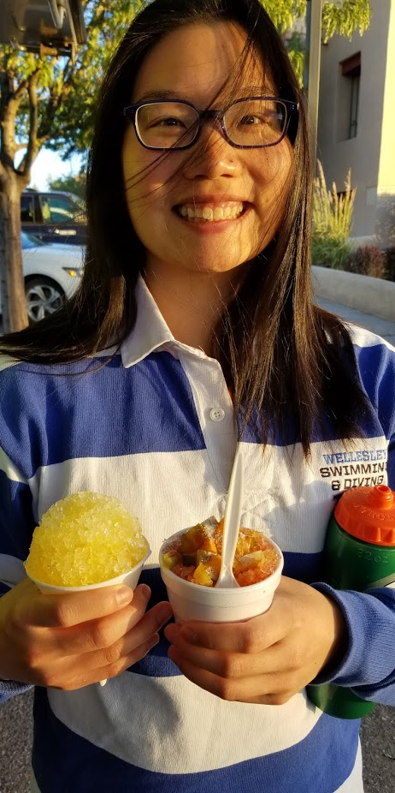
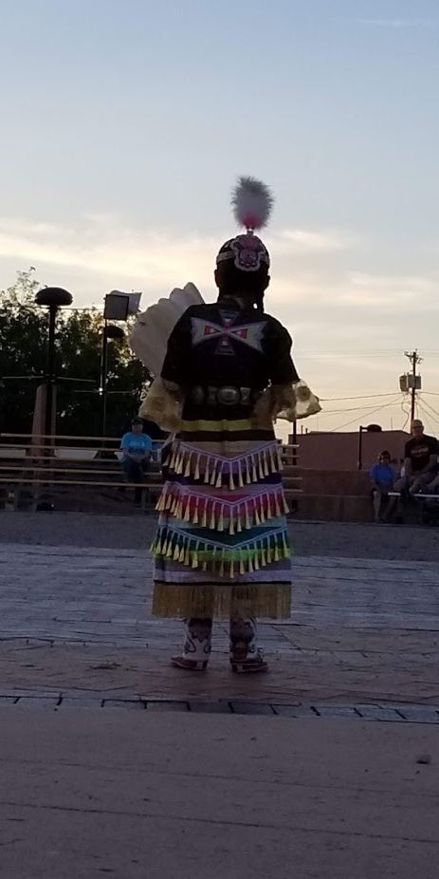
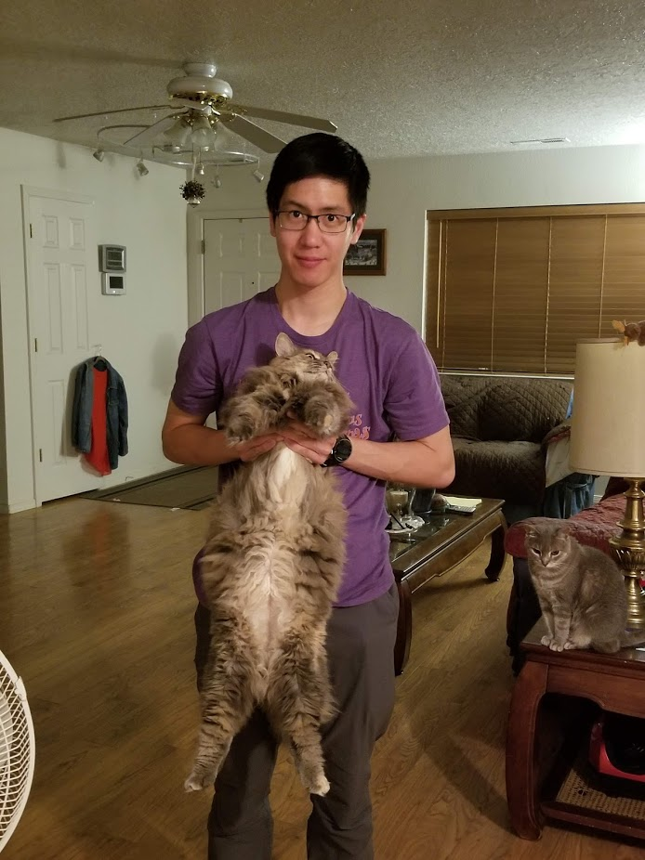
Why did we want to go?
Microcosm of a different culture within our country
Increase cultural competency
Truth behind Thanksgiving? Puritans and “Indians”?
Never been out to that area
We love hiking!
Notes:
Indian picadilly
6 cats and 3 dogs at our Airbnb

Slide 6
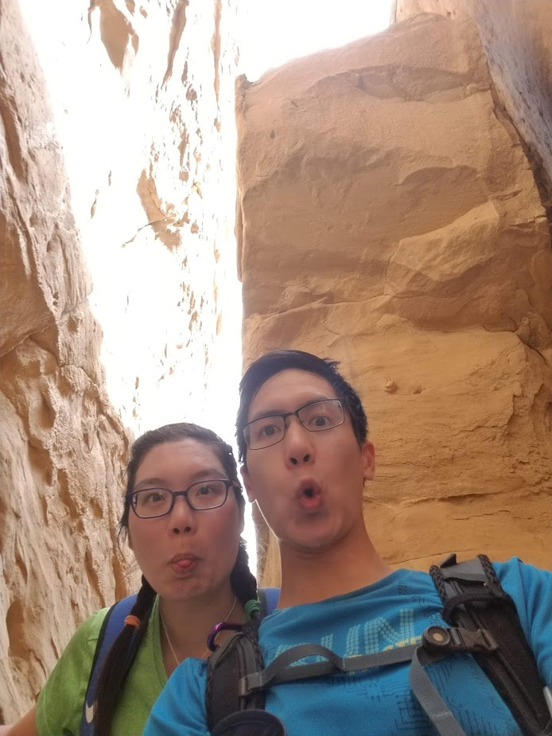
What was our role?
Tiffany:
Family Medicine student
Jason:
Pediatrics student
Outpatient family medicine clinic
Inpatient hospitalist medicine
Outpatient geriatrics clinic
Palliative care service (inpatient and outpatient)
Home visits
Labor and Delivery with FM fellow
Shadowing Public Health Nurses
Learn about Traditional Medicine with Galen Ben
Outpatient pediatrics clinic
Inpatient pediatrics service
Newborn Nursery service
Behavior Health Services Intake
Child Development Assessment
Shadowing Public Health Nurses
Learn about Traditional Medicine with Galen Ben

Slide 7
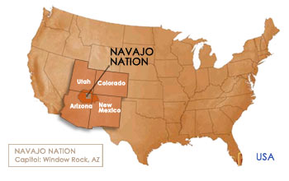
Southwest USA
Where did we go?
Notes:
https://navajobusiness.com/fastFacts/LocationMap.htm

Slide 8
Notes:
2.5 hour drive from Albuquerque to Gallup
We had a rental car

Slide 9
How did we get there?
Starting prepping in December of third year- IHS sites book up very fast
Dr. Coates (Rural health connection) at Zuni site, no room for students
Very “easy” Indian Health Service (IHS) website
https://www.ihs.gov/careeropps/studentopportunities/
https://www.ihs.gov/careeropps/studentopportunities/residencies-and-rotations/
https://www.ihs.gov/careeropps/contactrecruiter/
Lots of back and forth emails with contacts from the site
Online training, paperwork via mail, fingerprints at the police station (government paperwork)
Rotation logistics: Found housing through contacts from Dr. Vaughn (we covered our own room and board), booked rental car
Need at least 6 weeks heads up
IMPORTANT: Gallup Indian Medical Center is currently the ONLY IHS site UMass Med has an official relationship with. If you want to go on an IHS rotation, this is the ONLY site you can go to.

Slide 10
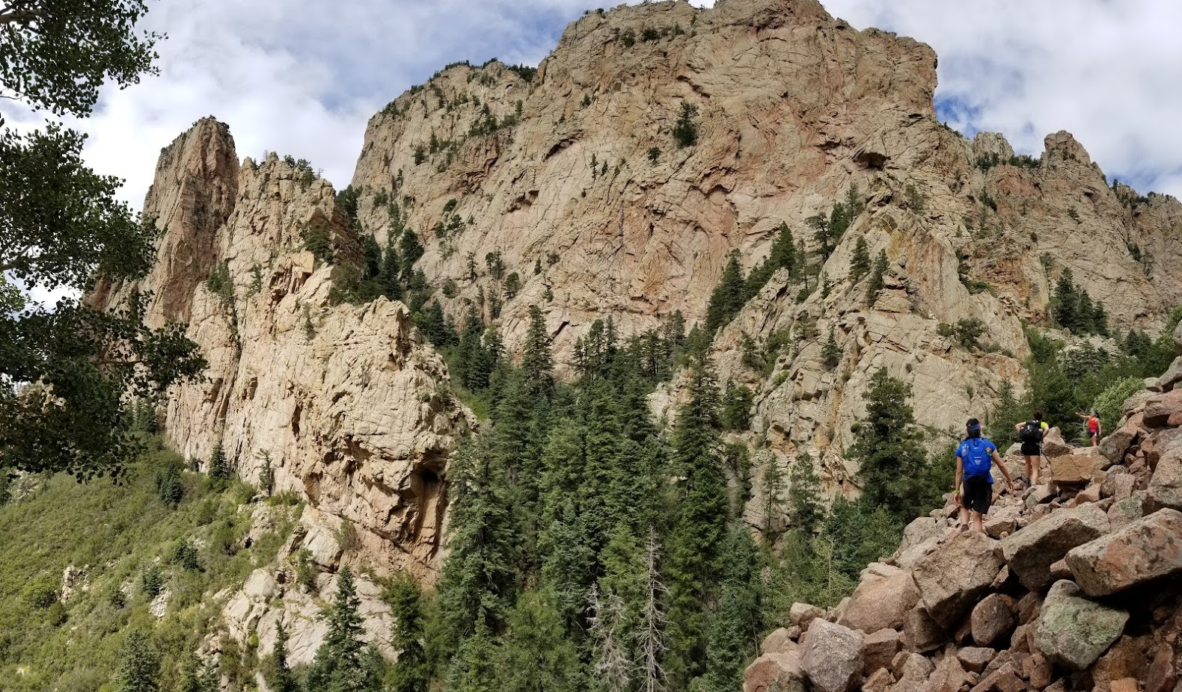
Stories and Lessons
Cathedral Rock (Sedona, Arizona)
La Luz Trail (Albuquerque, New Mexico)
Notes:
La Luz (Albuquerque, New Mexico) Sedona (Arizona)

Slide 11
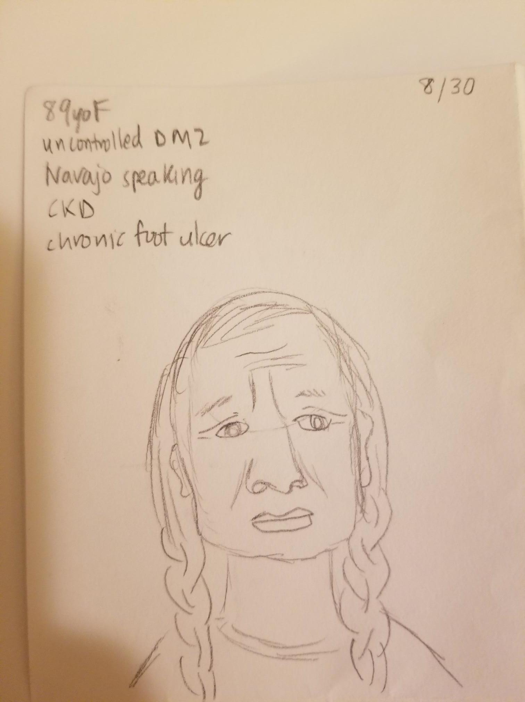
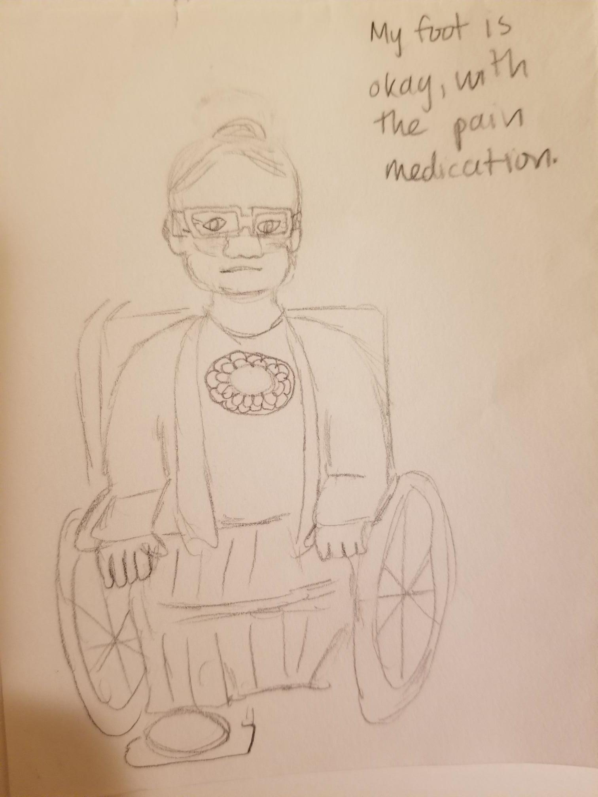
Pervasive diseases: but people are not textbook
Childhood obesity
Diabetes
Alcohol abuse and cirrhosis
“Navajo people- for some, alcohol is sacred like water. It is a meaningful relationship to them.” ~social worker
Depression
Suicides
89yo F uncontrolled DM2, Navajo speaking, CKD, chronic foot ulcer

Slide 12
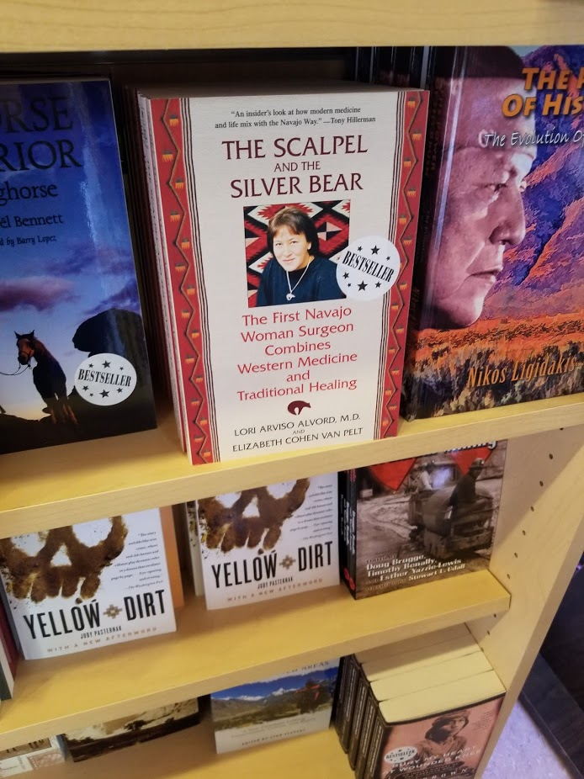
Perception towards Western Medicine
Distrust of doctors: story of a grandma
Language shapes reality
Providers don’t reflect the patient population, cultural humility means learning and reflecting everyday
Death and dying: dying at home is still not favored
Notes:
Tiff- story of a grandma-Story Grandma is mom of one of social workers and really bad diabetes, agreed to palliative care, really ashamed of amputation, distrusted doctors, afraid to be a burden to her daughter, suffering a heart attack two weeks later and dying in hospital and daughter needed to stop the code herself. All stemmed from fear of the doctor

Slide 13
Traditional Medicine
True traditional Medicine vs Peyote
Galen Ben
One of ten Navajo Traditional Medicine Mans left
He is one of the younger ones, in his 40s-50s, spent years as an apprentice
Traditional Medicine Dying out
Generational changes
Notes:
Background: true traditional medicine, peyote (traditional medicine practiced in secrecy during forced Christian conversion)
Arranged to meet with Galen
At gallup – one of 10 Navajo traditional medicine mans left. He is one of the younger ones in his 40s-50s. Spent years as an apprentice
Gallup is fortunate to have their own Hogan and have a traditional medicine man that people can refer to. Neighboring community like Chinle, doesn’t have a traditional medicine man but rather people who are trained enough to understand the practice and.
Fortunate enough to spend 3 hours with him recalling the creation story of the Navajo people and how the different ceremonies are based off them. Everything is intertwined into stories. The symbolism of the Hogan

Slide 14
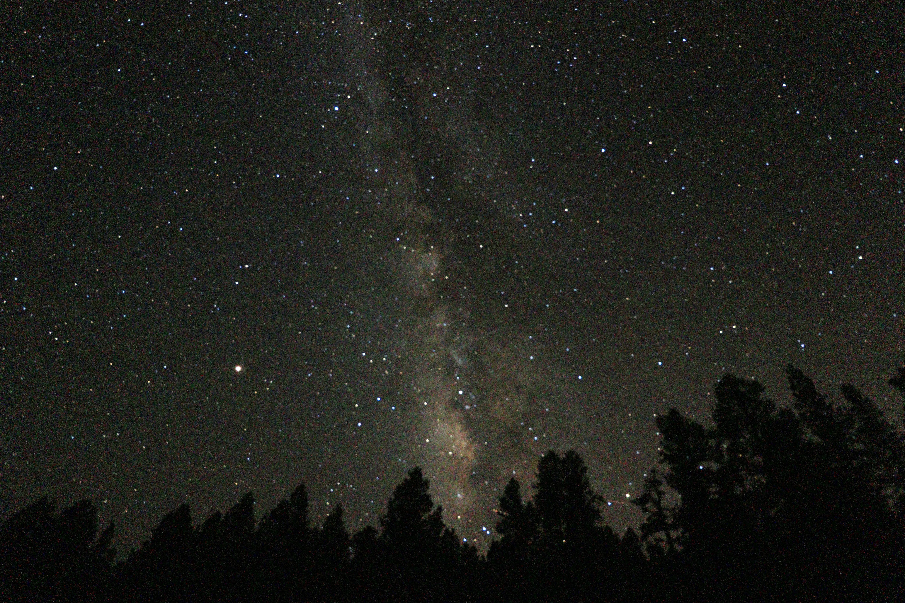
Relationship With Nature
Arizona and New Mexico have some of the darkest skies in the country
Milky way every night
Dark sky festivals for astronomers and astrophotography enthusiasts
Notes:
Bring back where you are and how much we can see
Didn’t have cellphone coverage 100% of the time, made sure to plan a month when we weren’t receiving interviews for residency
New Mexico and Arizona some of the darkest skies in the country – every night could see a milkway
We had the opportunity to learn about their way of living
Corn pollen – holy water, sprinkle corn pollen for every ceremony, I learned about growing corn, and collecting the pollen facing east and without breaking the stems
Going onto the reservation – through the phn, one of my trips, invited into their house,
I got to do the two week old well baby checkup in the comfort of their home
Talk to mom about lactation

Slide 15
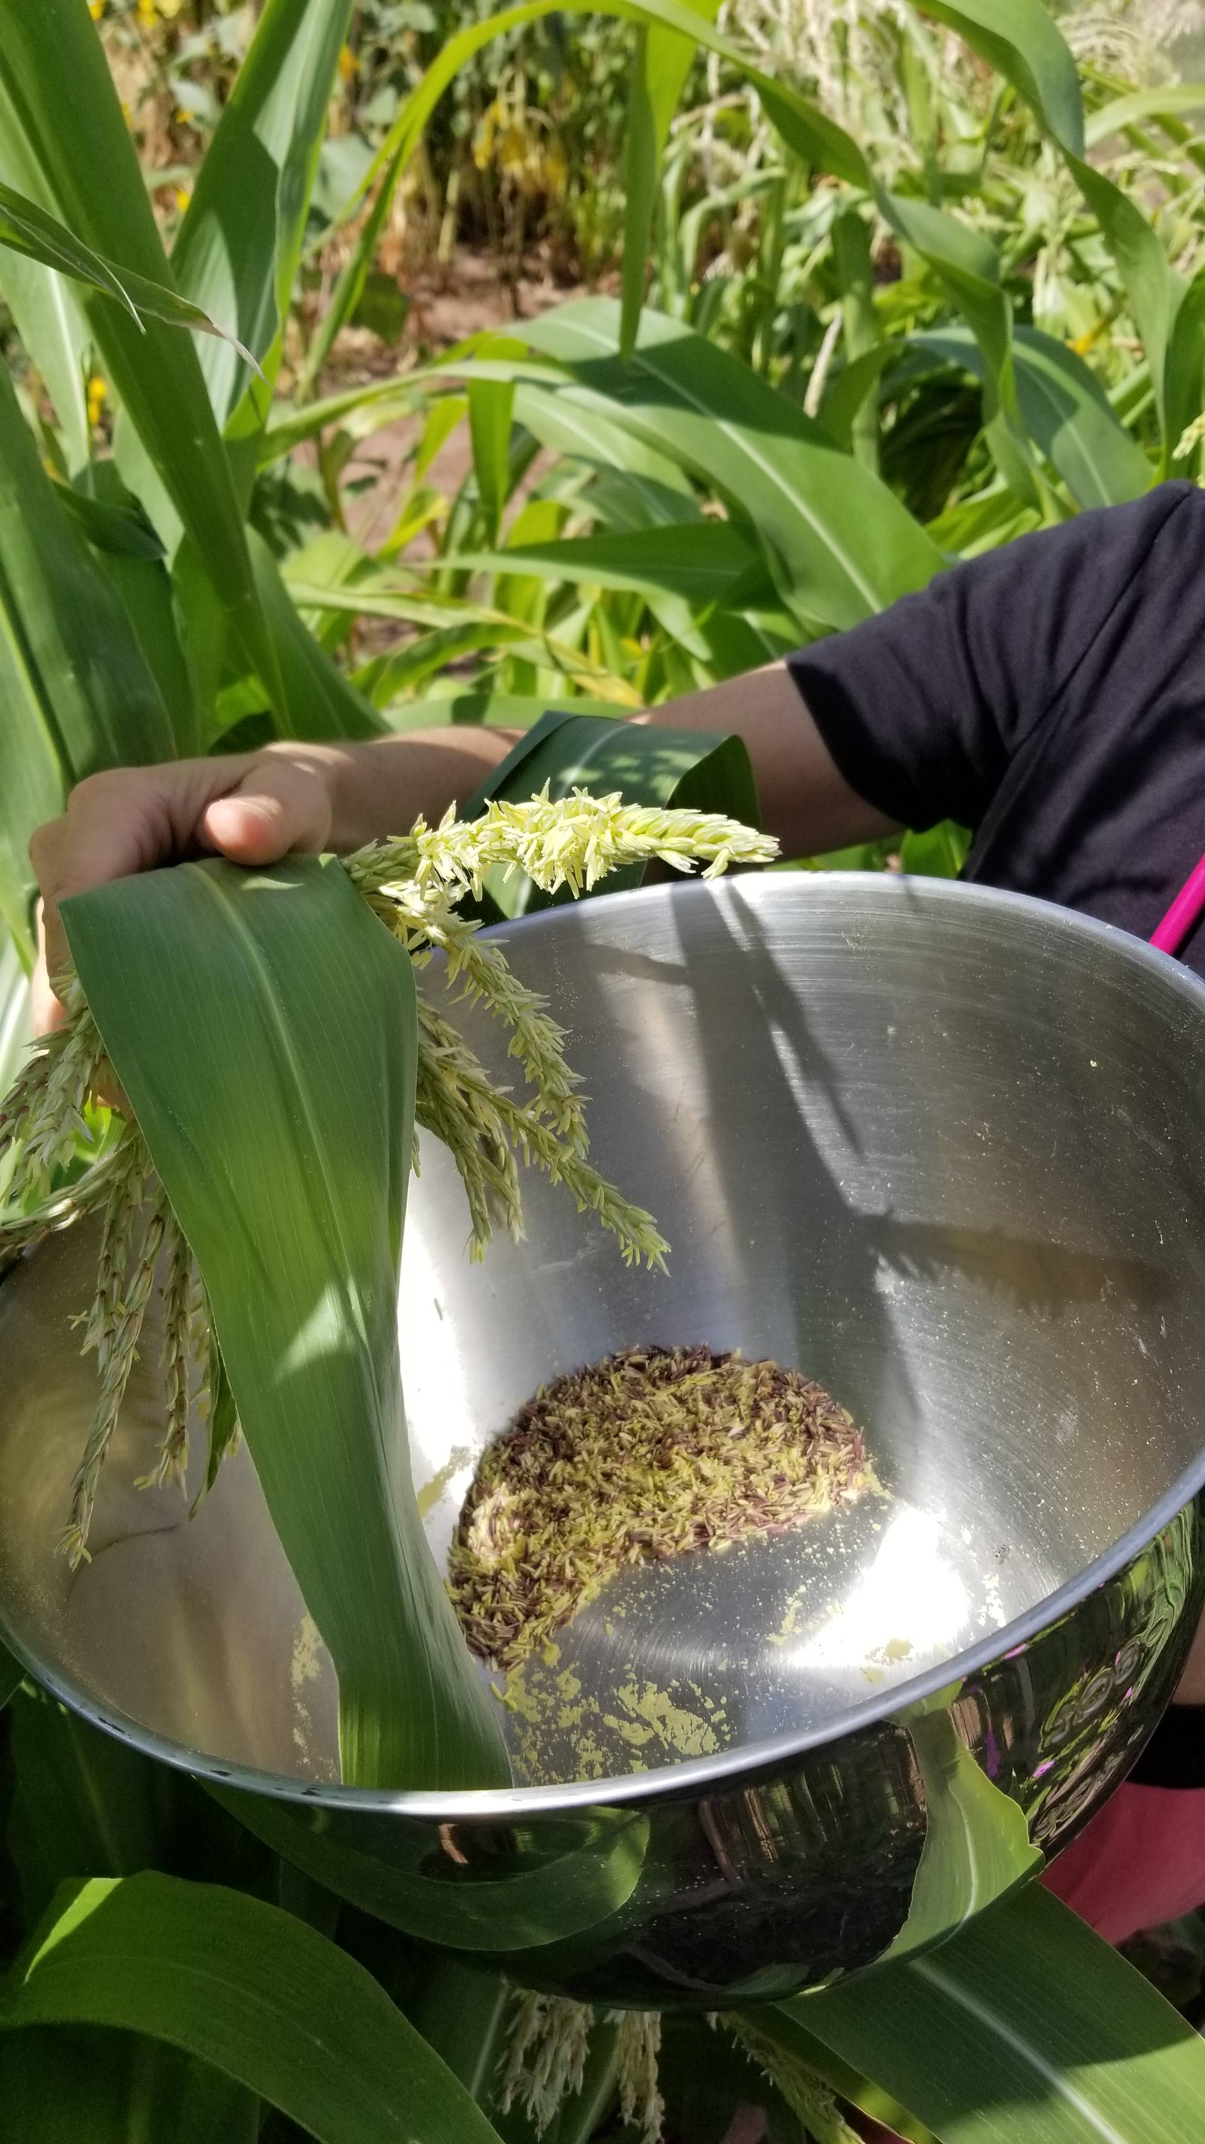
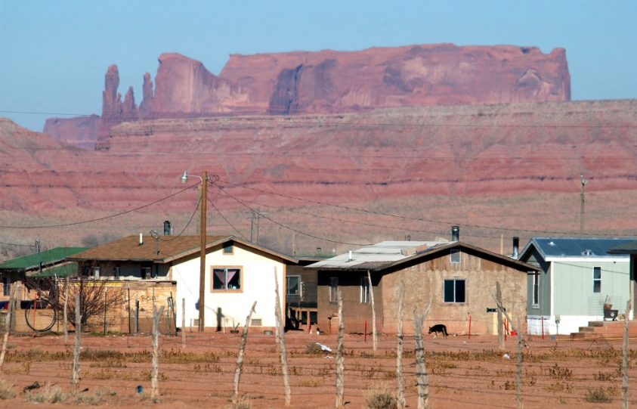
Relationship With Nature
Corn Pollen
“holy water” of Navajo ceremonies
Used in all ceremonies
Growing and collecting to learn their culture
Public Health Nurse (PHN) trips onto the reservation
Bridge between clinic providers and social workers
Many people travel two hours to get to clinic
Have to decide between gas money for groceries or health
“No one doesn’t want running water or electricity”
Notes:
Bring back where you are and how much we can see
Didn’t have cellphone coverage 100% of the time, made sure to plan a month when we weren’t receiving interviews for residency
New Mexico and Arizona some of the darkest skies in the country – every night could see a milkway
We had the opportunity to learn about their way of living
Corn pollen – holy water, sprinkle corn pollen for every ceremony, I learned about growing corn, and collecting the pollen facing east and without breaking the stems
Going onto the reservation – through the phn, one of my trips, invited into their house,
I got to do the two week old well baby checkup in the comfort of their home
Talk to mom about lactation
Fantastic experience but need to get papers in early or even before you go, it takes a while to get approval

Slide 16
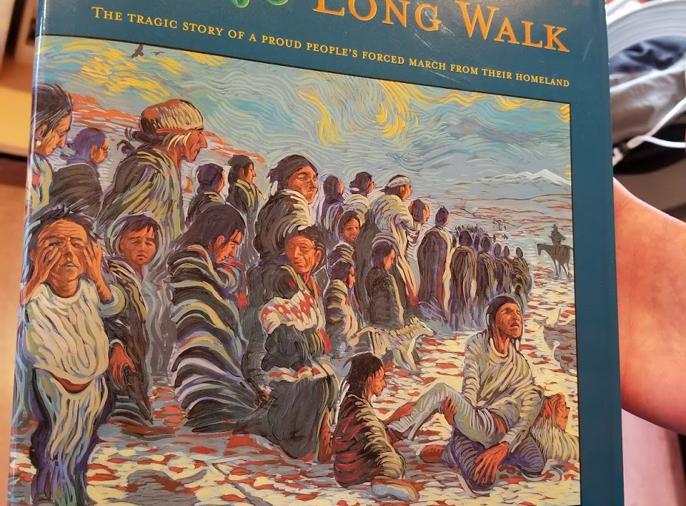
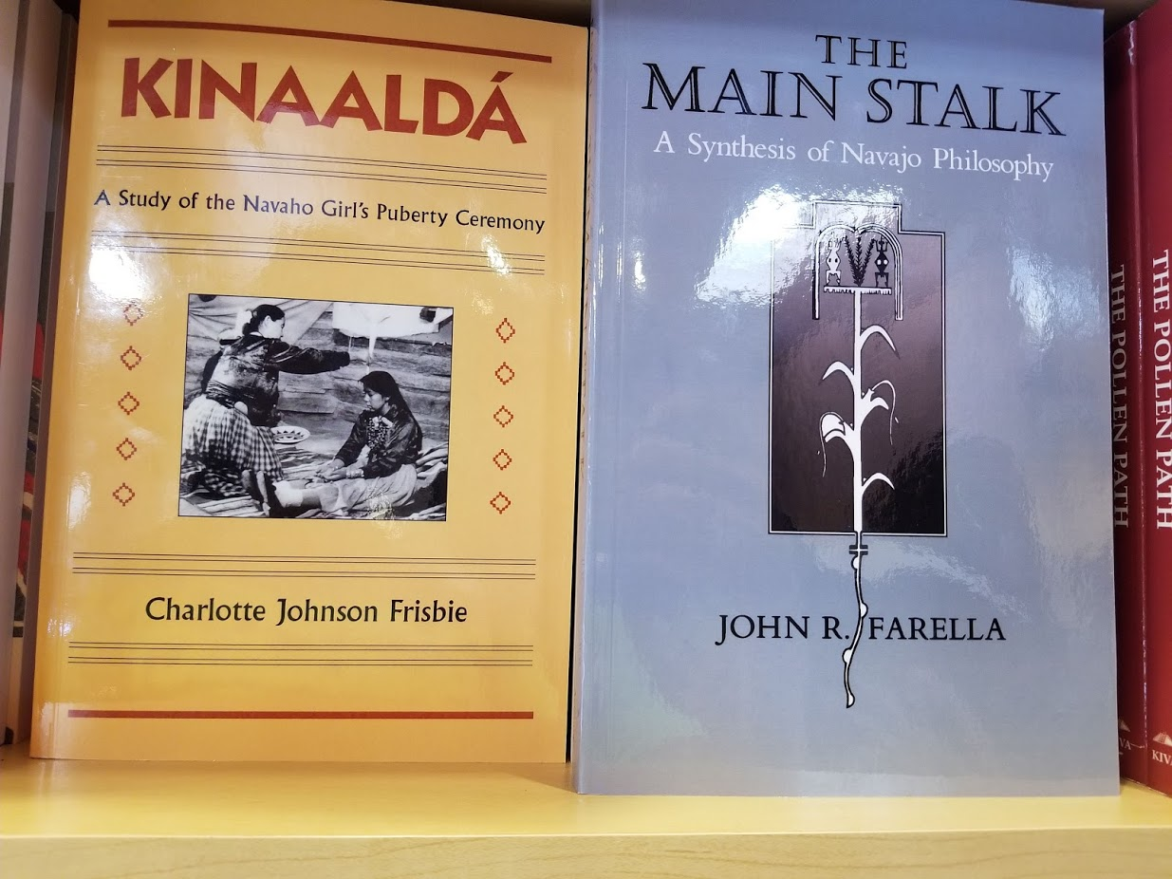
Resilience
Public health nurses (PHN) experience and seeing ability to survive and adapt
“Traditional” Indian frybread is the result of historical trauma (flour and lard)
Hózhó, walking in the beauty way
Transgender clinic for adults: story of a woman who lived through multiple violent relationships
Notes:
PHN experience – people build their own homes, find creative ways to rig up electricity and water
Hozho is talking about taking care of the whole person, integrating culture, family, wellness
https://www.ncbi.nlm.nih.gov/pmc/articles/PMC4424938/
Indian frybread came from the government sending them away from their crops, land and giving them flour and lard to survive

Slide 17
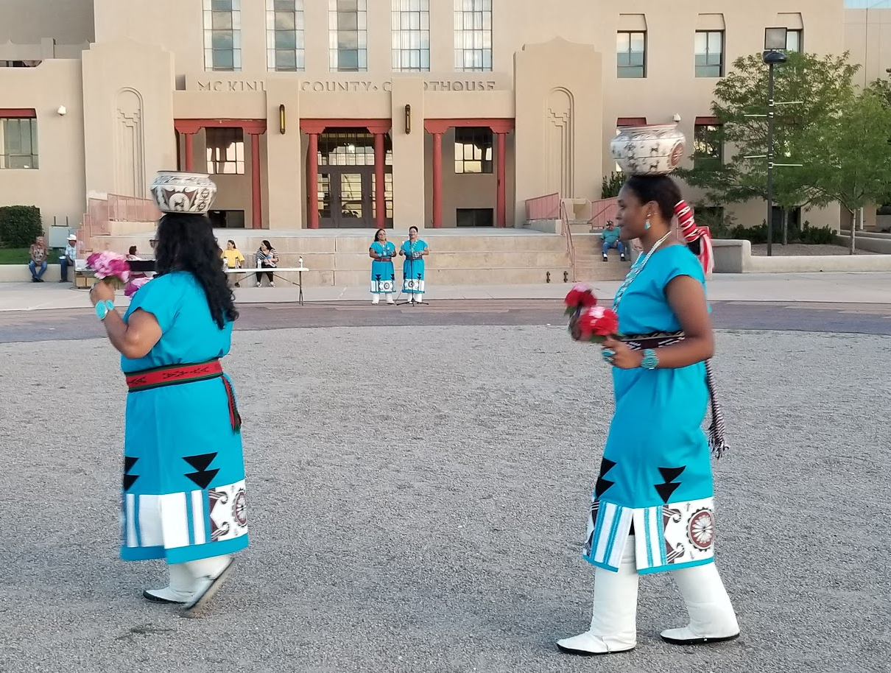
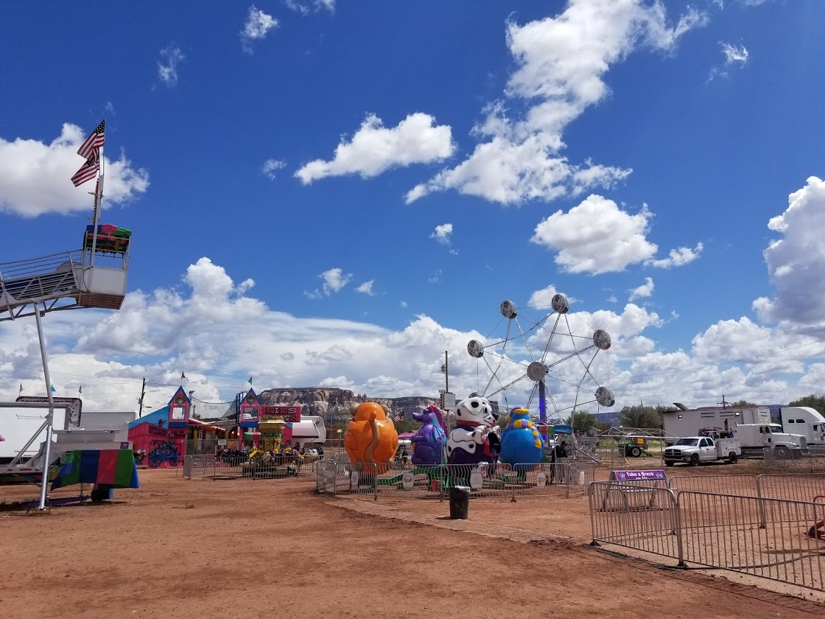
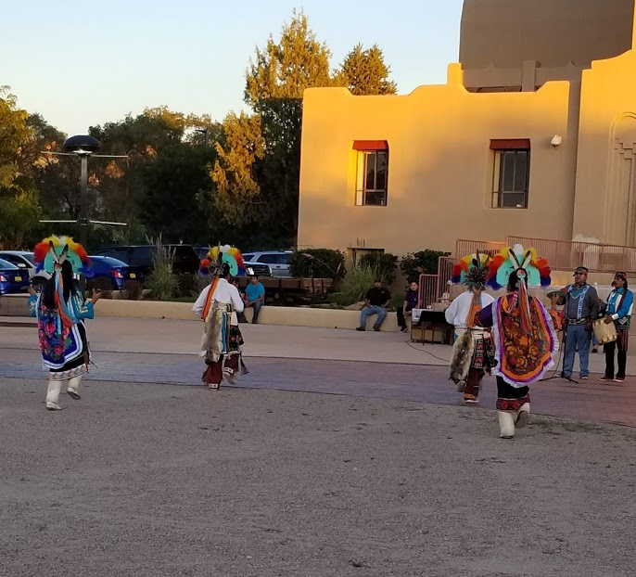
Celebration and Tradition
Notes:
Many festivals throughout the summer celebrating the Native American culture
Weekend flea market with Native artisans
Nightly Indian dances the first week we were there

Slide 18
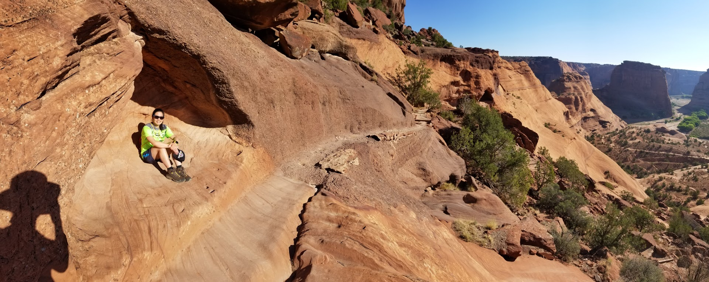
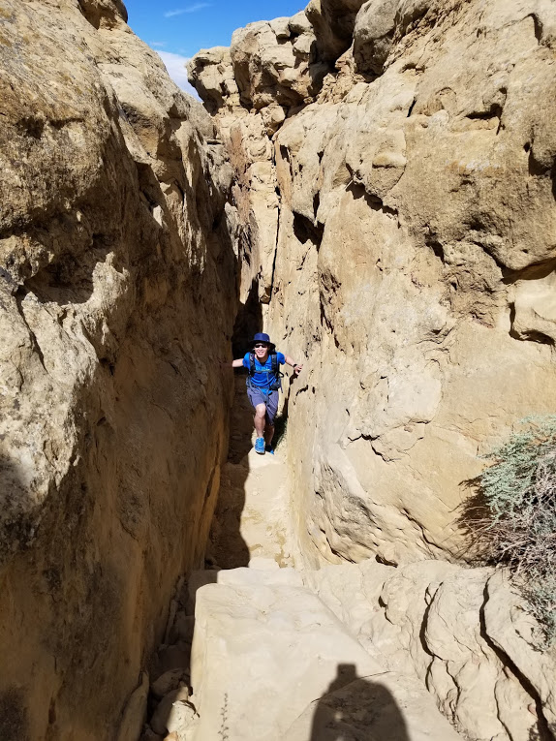
Takeaways
Canyon de Chelly (NM)
Pyramid Rock (Red Rock State Park, NM)
Chaco Canyon (NM)
Notes:
Chaco Canyon
Red Rock State Park
Canyon de Chelly

Slide 19
Changing our attitudes
Opportunities are not the same: no work in Gallup, many drive 2 hrs to Albuquerque, work in service, fast food everywhere
Diseases are not just genetic predisposition
They are still recovering from historical trauma
“No one doesn’t want running water or electricity” ~a PHN
Transgender adolescent clinic
Some families are very open and supporting of their children
Navajo people do not want to ignore talking about death, they just want it done respectfully

Slide 20
Respectful conversations about serious illness
Ask permission: How much do you wish to know?
Probe the patient: What brings you joy? What are you worried about?
Emphasize hopes and wishes that you have for the patient
Story: Grandpa sees grandson playing war in the backyard, “Don’t talk about death like that”
Speak in the third person to avoid the impression of wishing misfortune on the patient “Other patients have…”

Slide 21
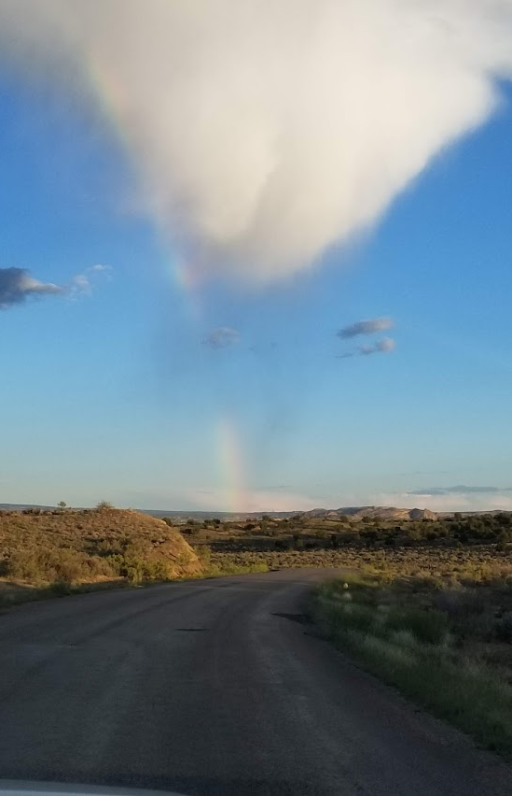
Would we go again?
Humility
Immersion in one of the most beautiful places in the country
Understanding the historical trauma and resilience of Native American people today

Slide 22
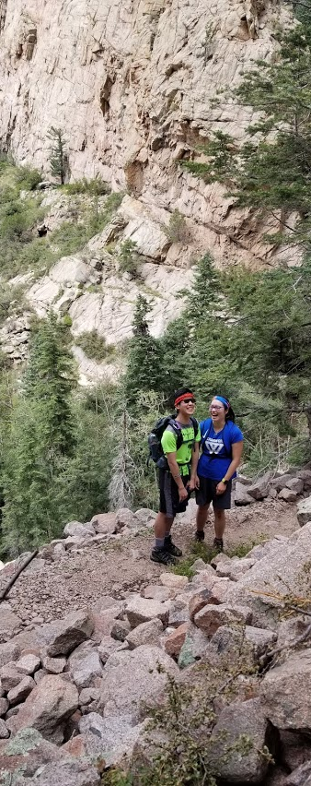
Thank you!
Interested in a Family Medicine rotation?
Tiffany Chen: tiffany.chen@umassmed.edu
Dr. Gary Vaughn: gary.vaughn@ihs.gov
Interested in a Pediatrics rotation?
Jason Lau: Jason.lau@umassmed.edu
Dr. Gilberto Alvarez: gilberto.alvarez@ihs.gov
Transgender medicine
Dr. Jennie Wei: jennie.wei@ihs.gov
https://hscmediasite.unm.edu/Mediasite/Catalog/Mobile/FolderPresentation/eb28295375ac4ea2b63fc7bb1791173621/36618f77-f6d6-4065-ad67-aaabd07565b5/3b0ff9bc271641e6a5cca128a8b09e541d/
https://lungbiology.ucsf.edu/news/fom/frontiers.html?key=101&title=You+Will+Become+Well
Email us ANY time with any questions!
Thanks for listening ☺
Notes:
Thanks to Suzanne for giving us the opportunity to give this presentation, Cynthia Poblano for having us in her home, countless preceptors at the Gallup Indian Medical Center, and the patients for letting us have a glimpse of their lives

Slide 23
Serious Illness Conversations in a culturally competent way
Above all else, show empathy- use a lot of “I wish” statements
Be sensitive about culture and beliefs- don’t assume traditional nature
Give time to absorb info- repeat multiple times
Repetition: it has to be said multiple times to be true
Utilize interpreters
Ask permission: what do they want to know? Is there anything they don’t want to know?
Do NOT take away hope, shift hope
Be specific asking what their beliefs are

